Slide 1
Data Analytics
Lecture #9
Analysis of Variance (ANOVA)

Slide 2

Quote of the day..
Try not to become a person of success, but rather try to become a person of value.
Albert Einstein, Theoretical physicist

Slide 3

This presentation includes…
What is “Analysis of variance”?
Why ANOVA?
How ANOVA?
$One−way ANOVA$
Two$−way ANOVA$

Slide 4
What is Analysis of Variance?

Slide 5
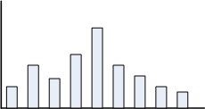
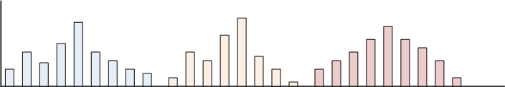
What is analysis of variation?

Slide 6


Example : Single vs. Multiple population

Slide 7
What is the issue?
Are the statistical inference valid?
µ
σ

Slide 8
Example 1: The issue in Statistical Testing
What if it affected the results of the students in a negative way?
or
What kind of music would be a good choice for this?
We should have some proof that it actually works or not.
A recent study claims that using music in a class enhances the concentration and consequently helps students absorb more information.

Slide 9
Design of Experiment
The teacher decided to implement it on a smaller group of randomly selected students from three different classes.
Three different groups of ten randomly selected students from three different classrooms were taken.
Each classroom was provided with three different environments for students to study.
Classroom A had constant music being played in the background
Classroom B had variable music being played in the background
Classroom C was a regular class with no music playing
A test was conducted after one month for all the three groups and their test scores were collected.

Slide 10
Test Result
 | Test scores of students (out of 10) |  |  |  |  |  |  |  |  |  | Mean
Class A (constant music) | 7 | 9 | 5 | 8 | 6 | 8 | 6 | 10 | 7 | 4 | 7
Class B (variable music) | 4 | 3 | 6 | 2 | 7 | 5 | 5 | 4 | 1 | 3 | 4
Class C (no music) | 6 | 1 | 3 | 5 | 3 | 4 | 6 | 5 | 7 | 3 | 4.3
 |  |  |  |  |  |  |  | Grand Mean -> |  |  | 5.1

Slide 11
Observations from the results
It is noticed that the mean score of students from Group A is definitely greater than the other two groups, so the treatment must be helpful.
Maybe it’s true, but there is also a slight chance that we happened to select the best students from class A, which resulted in better test scores (remember, the selection was done at random).
This leads to a few questions:
How do we decide that these three groups performed differently because of the different situations and not merely by chance?
In a statistical sense, how different are these three samples from each other?

Slide 12
Why ANOVA?

Slide 13

Statistical Inferences
ANOVA is a statistical technique
It is similar in application to techniques such as t-test, z-test and χ²-test in that it is used to compare means and the relative variance between them.
Why not use t-test, z-test and χ²-test ?
Why analysis of variance for comparing means?

Slide 14
Analysis of Variance (ANOVA)
Definition 16.1
Analysis of Variance (ANOVA) is derived from a partitioning of total variability into its component parts.
ANOVA is a statistical technique that is used to check if the means of two or more groups are significantly different from each other.
ANOVA checks the impact of one or more factors by comparing the means of different samples.
This technique was invented by Sir Ronald Aylmer Fisher (1921), and is often referred to as Fisher’s ANOVA.

Slide 15
Using t-test
t-test is used to:
To infer mean of a single population
T-test can be used to compare two populations
However, t-test is not useful to compare mean of more than two populations

Slide 16
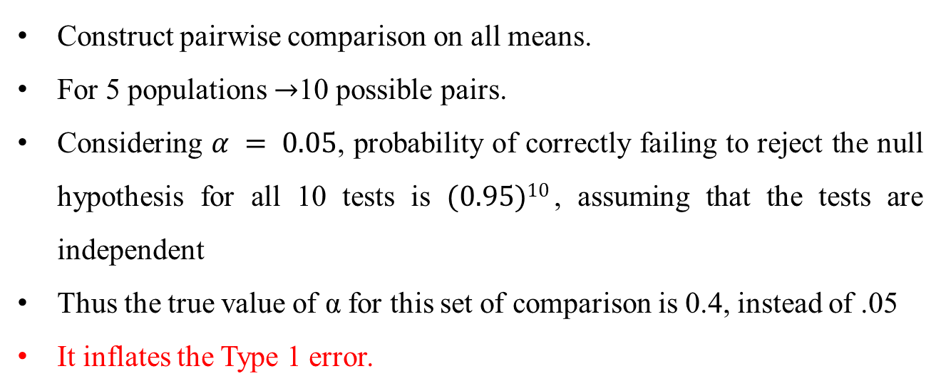
Extending the two population procedure
Construct pairwise comparison on all means.
For 5 populations $→$10 possible pairs.
Considering $α = 0.05$, probability of correctly failing to reject the null hypothesis for all 10 tests is $(0.95)10$, assuming that the tests are independent
Thus the true value of α for this set of comparison is 0.4, instead of .05
It inflates the Type 1 error.

Slide 17
Extending the two population procedure
Statistical Inference I
A car magazine wishes to compare the average petrol consumption of THREE models for car and has available SIX vehicles of each model.
There are THREE populations
There are samples each of size six from each population
Model 1 | Model 2 | Model 3

Slide 18
Extending the two population procedure
Statistical Inference II
A teacher is interested in a comparison of the average percentage marks obtained in the examinations of five different subjects and has available the marks of eight students who all completed each examination.
What is the number of populations?
How many samples? What are there sizes?? Are each samples independent to each other?
Subject 1 | Subject 2 | Subject 3 | Subject 4 | Subject 5

Slide 19
Example 2 : Why ANOVA?
Consider the two sets of contrived data as shown below:
Observations:
Looking only at the means, we can see that they are identical for the three populations in both the sets.
Using the means alone, we would state that there is no difference between the two sets.
Set 1 |  |  | Set 2
Sample 1 | Sample 2 | Sample 3 | Sample 1 | Sample 2 | Sample 3
5.7 | 9.4 | 14.2 | 3.0 | 5.0 | 11.0
5.9 | 9.8 | 14.4 | 4.0 | 7.0 | 13.0
6.0 | 10.0 | 15.0 | 6.0 | 10.0 | 16.0
6.1 | 10.2 | 15.6 | 8.0 | 13.0 | 17.0
6.3 | 10.6 | 15.8 | 9.0 | 15.0 | 18.0
y¯ = 6.0 | y¯ = 10.0 | y¯ = 15.0 | y¯ = 6.0 | y¯ = 10.0 | y¯ = 15.0

Slide 20
Box plots of the two experiments
Observation from Box plots
It appears that there is stronger evidence of differences among means in Set 1 than among means in Set 2.
The observations within the samples are more closely bunched in Set 1 than they are in Set 2,
We know that sample means from populations with smaller variances will also be less variable.
(Central Limit Theorem)
Thus, although the variances among the means for the two sets are identical, the variance among the observations within the individual samples is smaller for Set 1 and is the reason for the apparently stronger evidence of different means.
This observation is the basis for using the analysis of variance for making inferences about differences among means
The analysis of variance is based on the comparison of the variance among the means of the populations to the variance among sample observations within the individual populations.

Slide 21
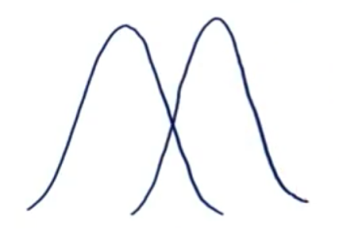
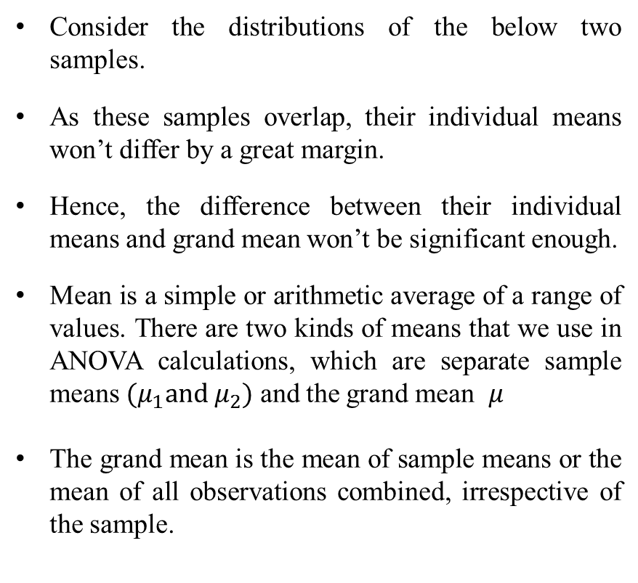
Between Group Variability
Variance among the means of the populations
Consider the distributions of the below two samples.
As these samples overlap, their individual means won’t differ by a great margin.
Hence, the difference between their individual means and grand mean won’t be significant enough.
Mean is a simple or arithmetic average of a range of values. There are two kinds of means that we use in ANOVA calculations, which are separate sample means $(μ_{1}and μ_{2})$ and the grand mean $μ$
The grand mean is the mean of sample means or the mean of all observations combined, irrespective of the sample.

Slide 22
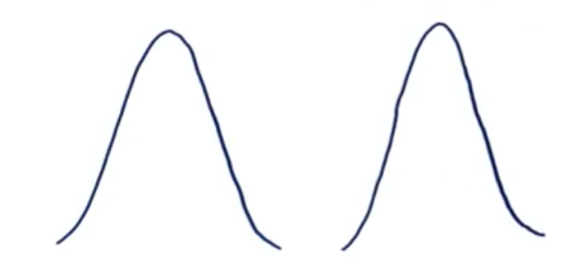
Between Group Variability
Now consider these two sample distributions. As the samples differ from each other by a big margin, their individual means would also differ. The difference between the individual means and grand mean would therefore also be significant.
Such variability between the distributions called Between-group variability or variance among the means of the populations.
Each sample is looked at and the difference between its mean and grand mean is calculated to calculate the variability.
If the distributions overlap or are close, the grand mean will be similar to the individual means, whereas if the distributions are far apart, difference between means and grand mean would be large.

Slide 23
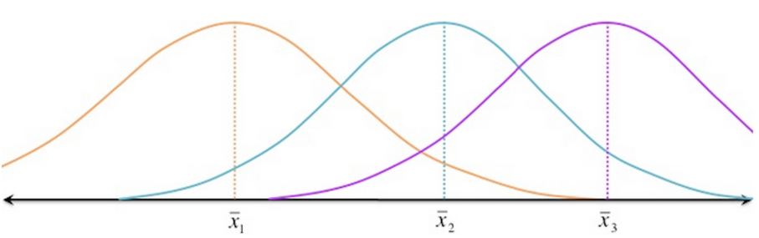
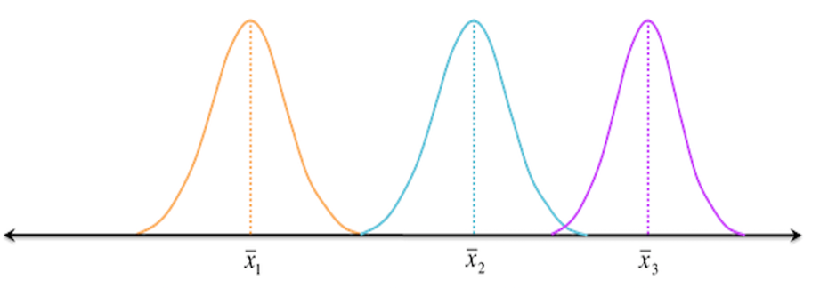
Within Group Variability
Variance among sample observations
Consider the given distributions of three samples. As the spread (variability) of each sample is increased, their distributions overlap and they become part of a big population.
Now consider another distribution of the same three samples but with less variability. Although the means of samples are similar to the samples in the above image, they seem to belong to different populations.

Slide 24
How ANOVA?

Slide 25
Some Terminologies
Factor
A characteristic under consideration, thought to influence the measured observations
Level (also called treatment)
A value of the factor
Typical data for a Single-Factor Experiment
Level | Observations |  |  |  | Total | Mean
1 | y₁₁ | y₁₂ | … | y_{1n1}
2 | y₂₁ | y₂₂ | … | y_{2n2}
… | … | … | … | …
… | … | … | … | …
… | … | … | … | …
k | y_{k1} | y_{k2} | … | y_{knk}

Slide 26
Example 3: Single-Factor ANOVA
Draw a straight line of between 20cm and 25 cm on a sheet of plain white card (only you know its exact length)
Collect 6 to 10 volunteers from each of Class VII, Class X and Class XII. Ask each volunteer to estimate independently the length of the line.
Do differences in year means appear to outweigh differences within years?
What is/ are the Factor(s) and Levels here?

Slide 27
Example 4 : Two-Factor ANOVA
Make a list of 10 food/household items purchased regularly by your family.
Obtain the current prices of the items in three different shops; preferably a small 'corner' shop, a small supermarket and a large supermarket or hyper market.
Compare total shop prices.
What is/ are the Factor(s) and Levels here?

Slide 28
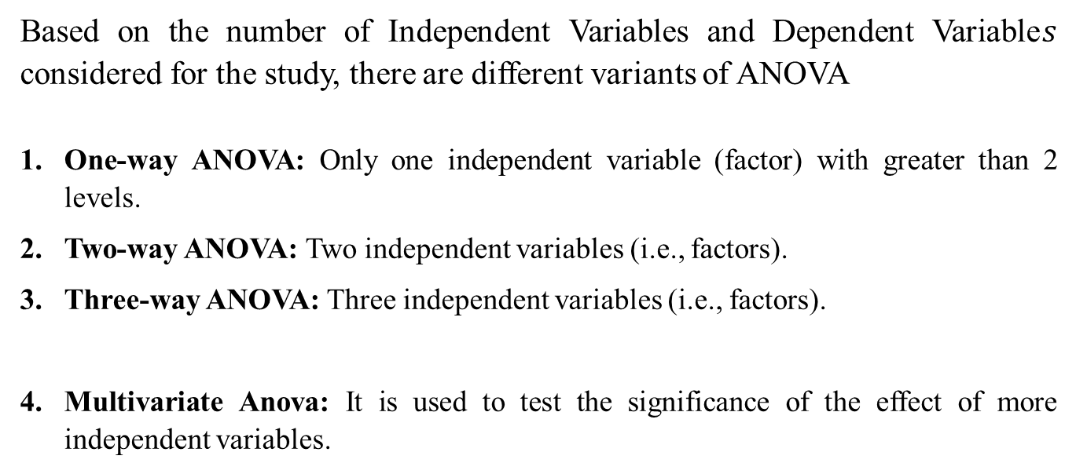
Variants of ANOVA
Based on the number of Independent Variables and Dependent Variable$s$ considered for the study, there are different variants of ANOVA
One-way ANOVA: Only one independent variable (factor) with greater than 2 levels.
Two-way ANOVA: Two independent variables (i.e., factors).
Three-way ANOVA: Three independent variables (i.e., factors).
Multivariate Anova: It is used to test the significance of the effect of more independent variables.

Slide 29
One-way ANOVA

Slide 30
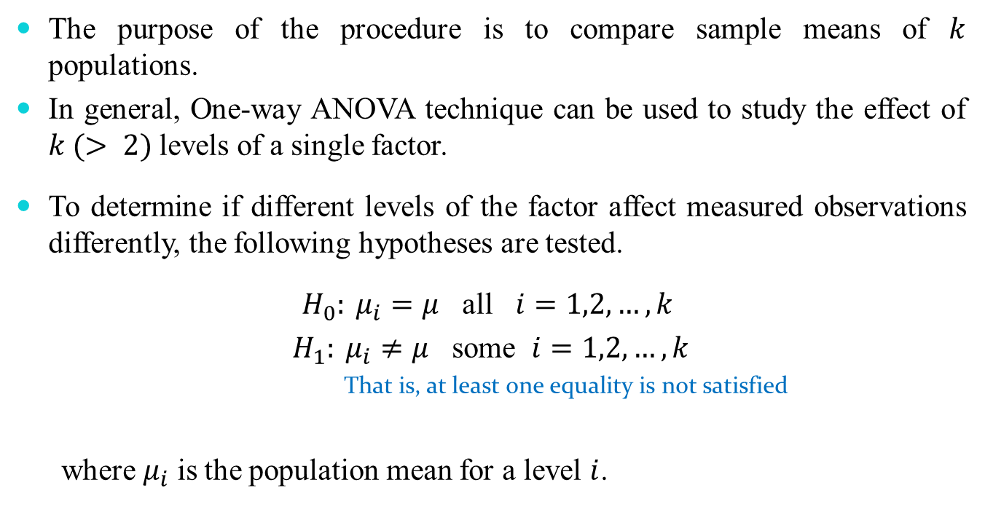
One-way ANOVA
The purpose of the procedure is to compare sample means of $k$ populations.
In general, One-way ANOVA technique can be used to study the effect of $k (> 2)$levels of a single factor.
To determine if different levels of the factor affect measured observations differently, the following hypotheses are tested.
$H_{0}: μ_{i}=μ$ all $i=1,2,…,k$
$H_{1}: μ_{i}≠μ$ some $i=1,2,…,k$
That is, at least one equality is not satisfied
where $μ_{i}$ is the population mean for a level $i$.

Slide 31
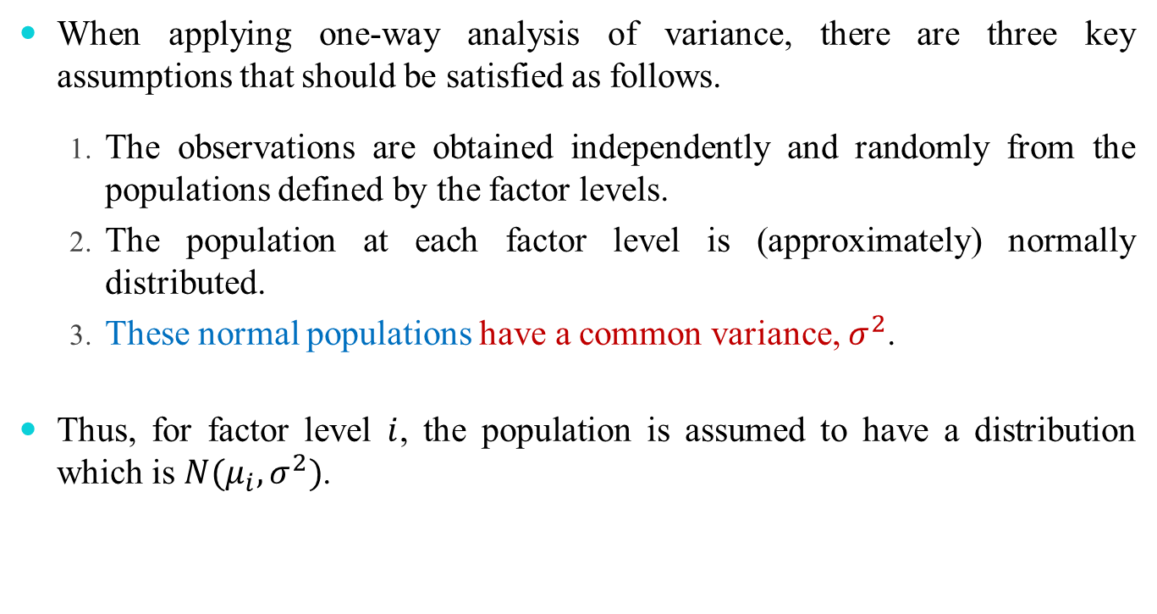
Assumptions
When applying one-way analysis of variance, there are three key assumptions that should be satisfied as follows.
The observations are obtained independently and randomly from the populations defined by the factor levels.
The population at each factor level is (approximately) normally distributed.
These normal populations have a common variance, $σ^{2}$.
Thus, for factor level $i$, the population is assumed to have a distribution which is $N(μ_{i},σ^{2})$.

Slide 32
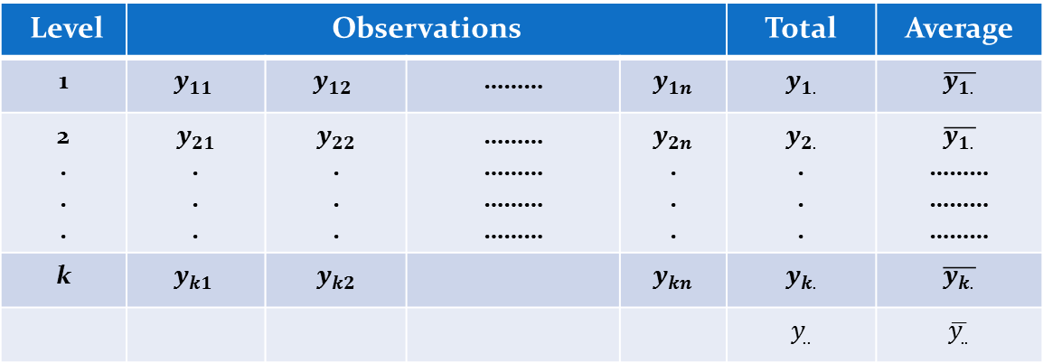
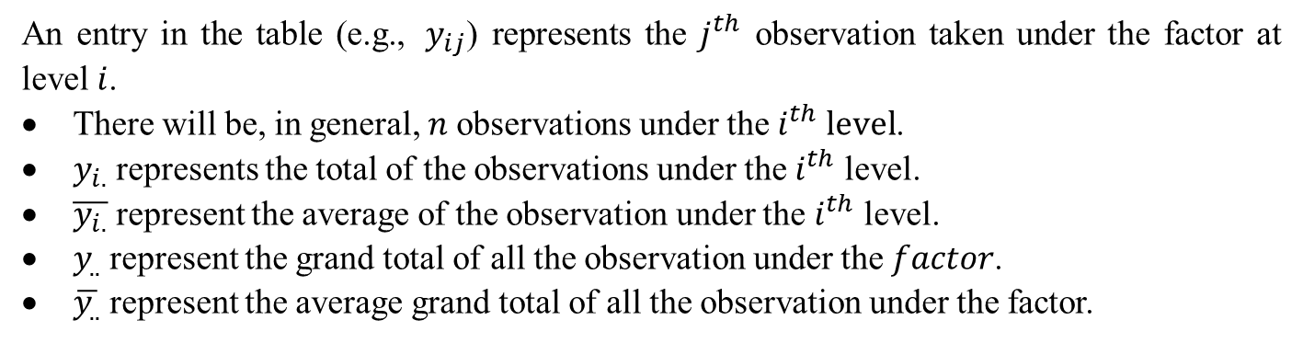
One-way ANOVA
Level | Observations |  |  |  | Total | Average
1 | $$y_{11}$$ | $$y_{12}$$ | ……… | $$y_{1n}$$ | $$y_{1.}$$ | $$\overline{y_{1.}}$$
2 . . . | $$y_{21}$$ . . . | $$y_{22}$$ . . . | ……… ……… ……… ……… | $$y_{2n}$$ . . . | $$y_{2.}$$ . . . | $$\overline{y_{1.}}$$ ……… ……… ………
k | $$y_{k1}$$ | $$y_{k2}$$ |  | $$y_{kn}$$ | $$y_{k.}$$ | $$\overline{y_{k.}}$$
 |  |  |  |  | $$y_{..}$$ | $$\overline{y_{..}}$$
An entry in the table (e.g., $y_{ij}$) represents the $j^{th}$ observation taken under the factor at level $i$.
There will be, in general, $n$observations under the${ i}^{th} level$.
$y_{i.}$ represents the total of the observations under the $i^{th}$ level.
$\overline{y_{i.}}$ represent the average of the observation under the $i^{th}$ level.
$y_{..}$ represent the grand total of all the observation under the $factor$.
$\overline{y_{..}}$ represent the average grand total of all the observation under the factor.

Slide 33

One-way ANOVA
Expressed symbolically,
$$y_{i.}=\sum_{j=1}^{ni}{y_{ij}} i=1,2,……,k$$
${\overline{y}}_{i..}=\frac{y_{i.}}{n_{i}}$
$$y_{..}=\sum_{i=1}^{k}{\sum_{j=1}^{ni}{y_{ij}}} \overline{y_{..}}={y_{..}}/N$$
Here, N is the total observations, that is, N = n_{i} + n₂ + …+n_{k}

Slide 34
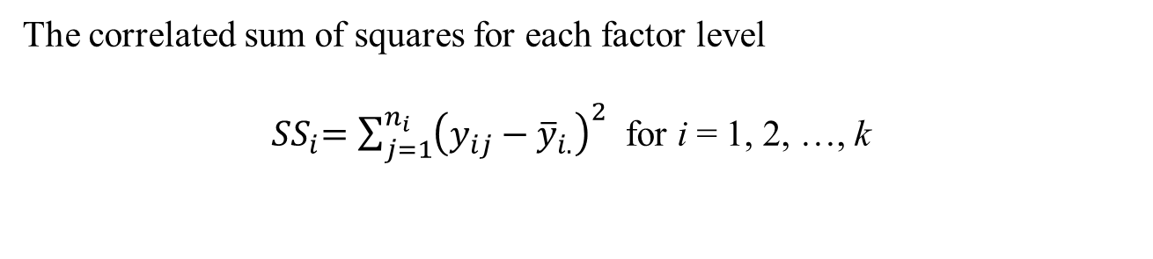
Overall Variability in Data
The correlated sum of squares for each factor level
${ SS}_{i}=\sum_{j=1}^{n_{i}}{{\left(y_{ij}−{\overline{y}}_{i.}\right)}^{2}}$ for i = 1, 2, …, k

Slide 35

Overall Variability in Data
The corrected sum of squares for each factor level
$${SS}_{i}=\sum_{i=1}^{n_{i}}{{(y_{ij}−\overline{y..})}^{2}}$$
Alternatively, it can be prove using the computational form that
$${SS}_{i}= \sum_{j=1}^{n_{i}}{y_{ij}^{2}−\frac{{\left(y_{i.}\right)}^{2}}{n_{i}}}$$

Slide 36

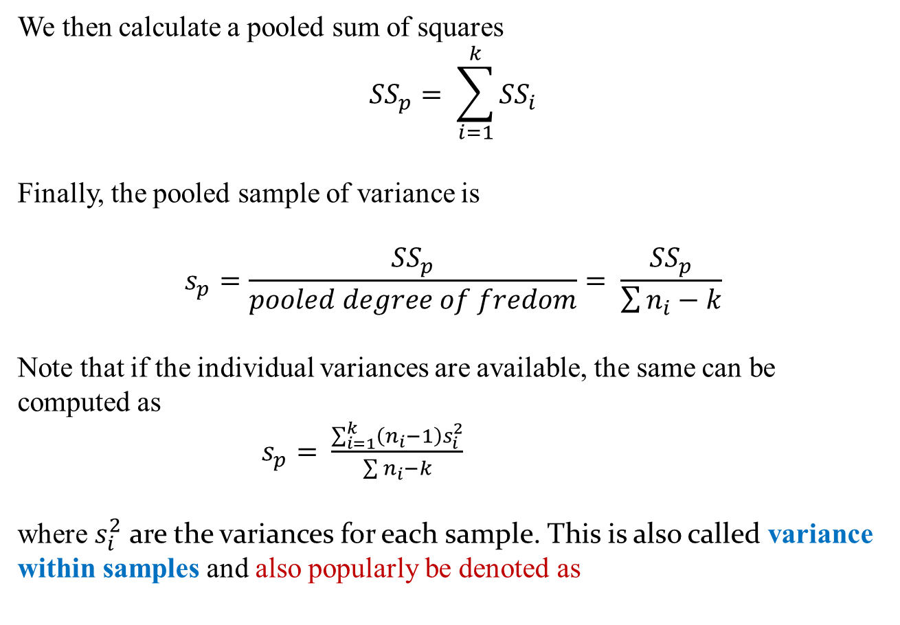
Overall Variability in Data
We then calculate a pooled sum of squares
$${SS}_{p}= \sum_{i=1}^{k}{{SS}_{i}}$$
Finally, the pooled sample of variance is
$$s_{p}=\frac{{SS}_{p}}{pooled degree of fredom}= \frac{{SS}_{p}}{\sum{n_{i}−k}}$$
Note that if the individual variances are available, the same can be computed as
$s_{p}= \frac{\sum_{i=1}^{k}{\left(n_{i}−1\right)s_{i}^{2}}}{\sum{n_{i}−k}}$
where $s_{i}^{2}$ are the variances for each sample. This is also called variance within samples and also popularly be denoted as
$${\hat{σ}}_{W}^{2}$$

Slide 37

Example 5: Variance within Samples
The table below shows the lifetimes under controlled conditions, in hours in excess of 1000 hours, of samples of $60W$ electric light bulbs of three different brands.
Brand
1 | 2 | 3
16 | 18 | 26
15 | 22 | 31
13 | 20 | 24
21 | 16 | 30
15 | 24 | 24

Slide 38

Solution : Variance within Samples
Here, there is one factor (brand) at three levels (1, 2 and 3). Also the sample sizes are all equal (to 5).
The sample mean and variance (divisor $(n −1)$) for each level are as follows.
 | Brand
 | 1 | 2 | 3
Sample Size | 5 | 5 | 5
Sum | 80 | 100 | 135
Sum of squares | 1316 | 2040 | 3689
Mean | 16 | 20 | 27
Variance | 9 | 10 | 11

Slide 39
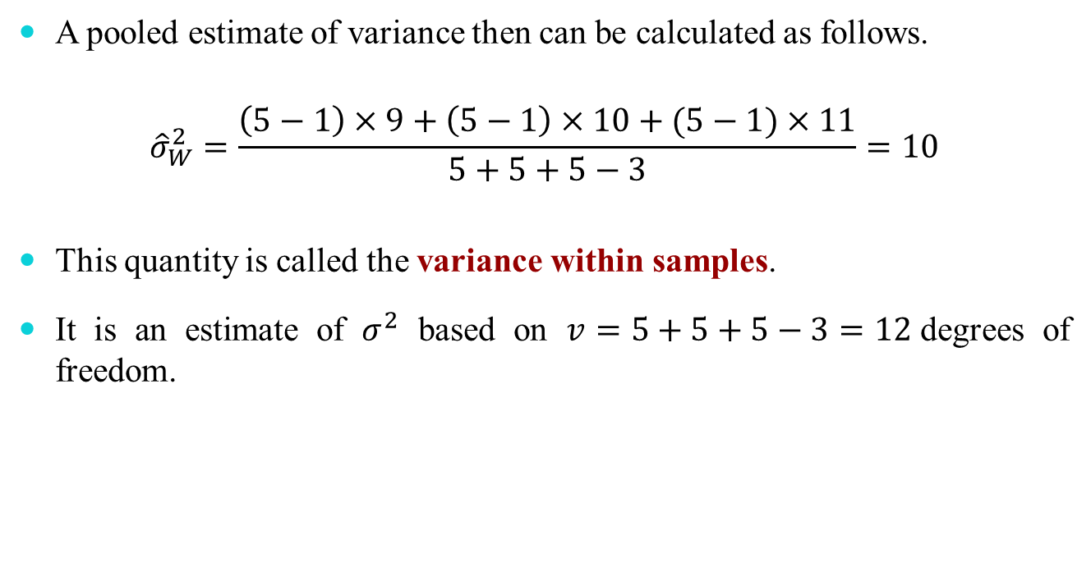
Solution : Variance within Samples
A pooled estimate of variance then can be calculated as follows.
$${\hat{σ}}_{W}^{2}=\frac{\left(5−1\right)×9+\left(5−1\right)×10+(5−1)×11}{5+5+5−3}=10$$
This quantity is called the variance within samples.
It is an estimate of $σ^{2}$ based on $v=5+5+5−3=12$degrees of freedom.

Slide 40
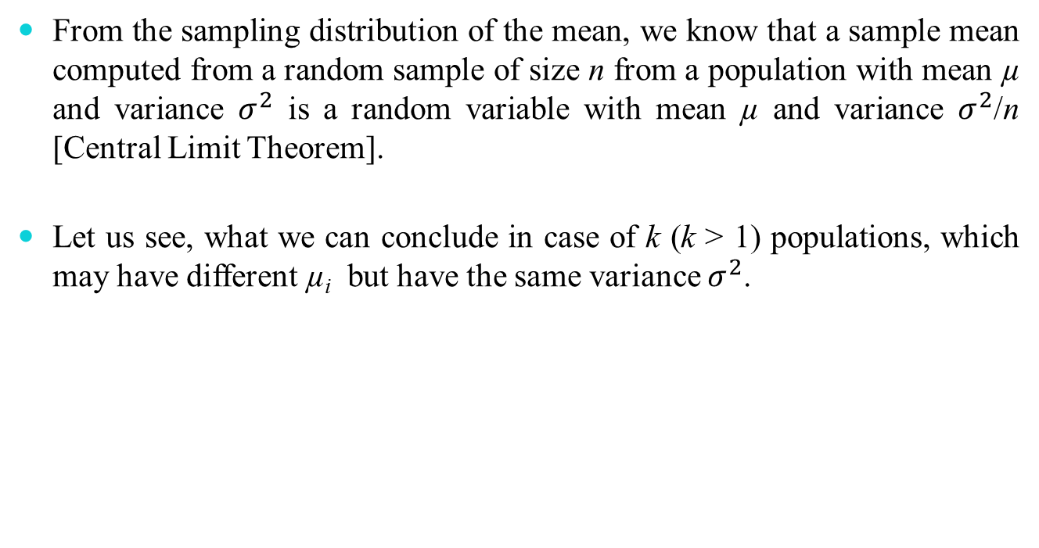
Heuristic Justification of ANOVA
From the sampling distribution of the mean, we know that a sample mean computed from a random sample of size n from a population with mean µ and variance $σ^{2}$ is a random variable with mean µ and variance $σ^{2}$/n [Central Limit Theorem].
Let us see, what we can conclude in case of k (k > 1) populations, which may have different µ_{i} but have the same variance $σ^{2}$.

Slide 41
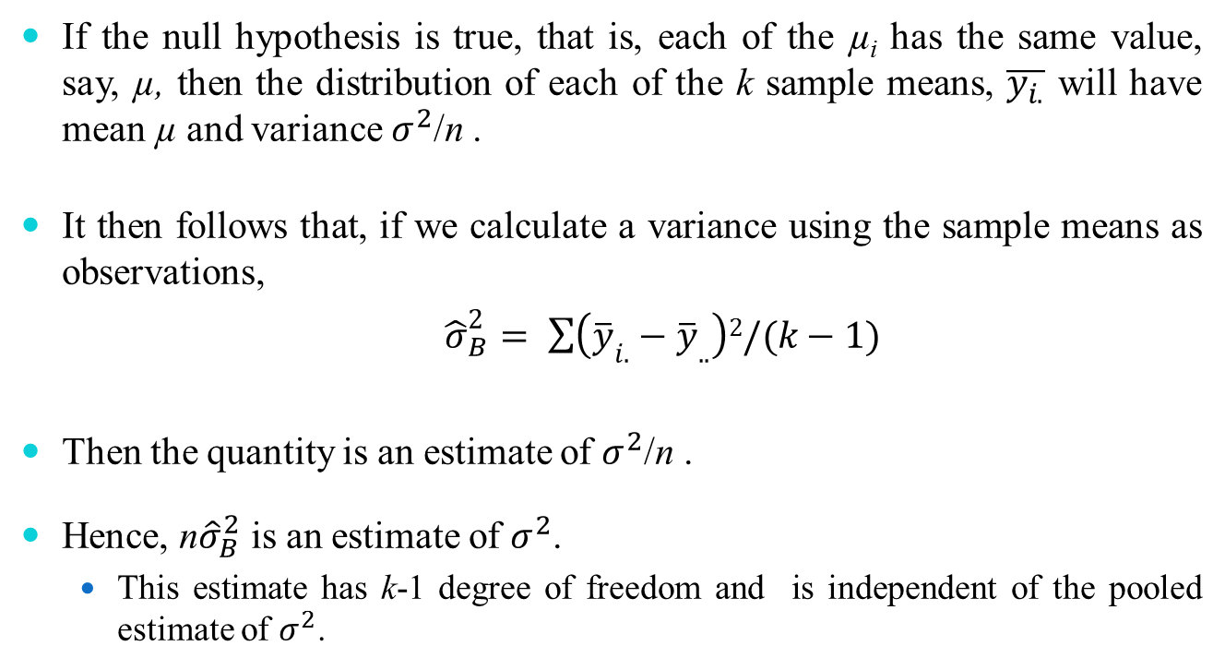
Heuristic Justification of ANOVA
If the null hypothesis is true, that is, each of the µ_{i} has the same value, say, µ, then the distribution of each of the k sample means, $\overline{y_{i.}}$ will have mean µ and variance $σ^{2}$/n .
It then follows that, if we calculate a variance using the sample means as observations,
${\hat{σ}}_{B}^{2}= \sum{\left({\overline{y}}_{i.}−{\overline{y}}_{..}\right)2/(k−1)}$
Then the quantity is an estimate of $σ^{2}$/n .
Hence, n${\hat{σ}}_{B}^{2}$ is an estimate of $σ^{2}$.
This estimate has k-1 degree of freedom and is independent of the pooled estimate of $σ^{2}$.

Slide 42
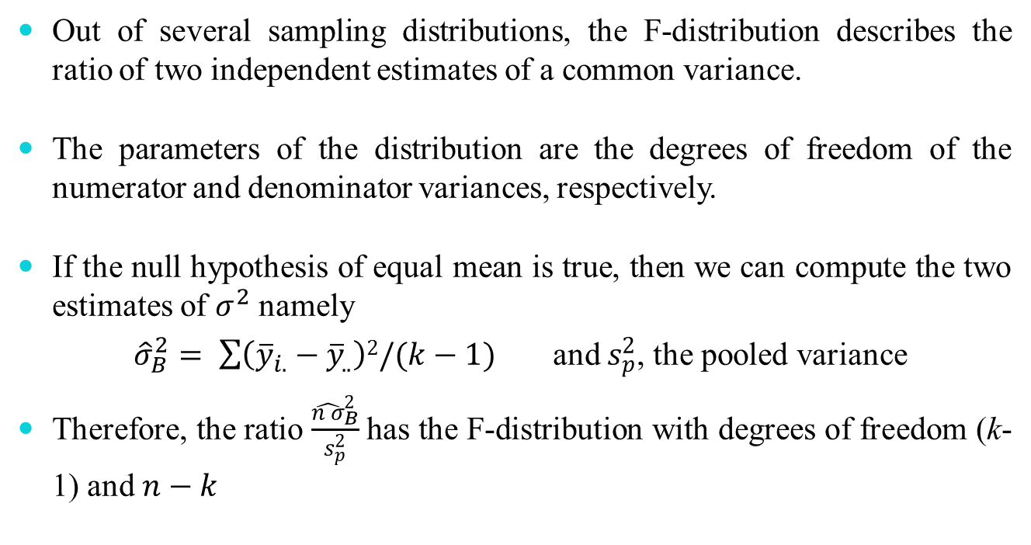
Heuristic Justification of ANOVA
Out of several sampling distributions, the F-distribution describes the ratio of two independent estimates of a common variance.
The parameters of the distribution are the degrees of freedom of the numerator and denominator variances, respectively.
If the null hypothesis of equal mean is true, then we can compute the two estimates of $σ^{2}$ namely
${\hat{σ}}_{B}^{2}= \sum{\left({\overline{y}}_{i.}−{\overline{y}}_{..}\right)2/(k−1)}$ and $s_{p}^{2}$, the pooled variance
Therefore, the ratio $\frac{{\hat{n σ}}_{B}^{2}}{s_{p}^{2}}$has the F-distribution with degrees of freedom (k-1) and $n−k$

Slide 43
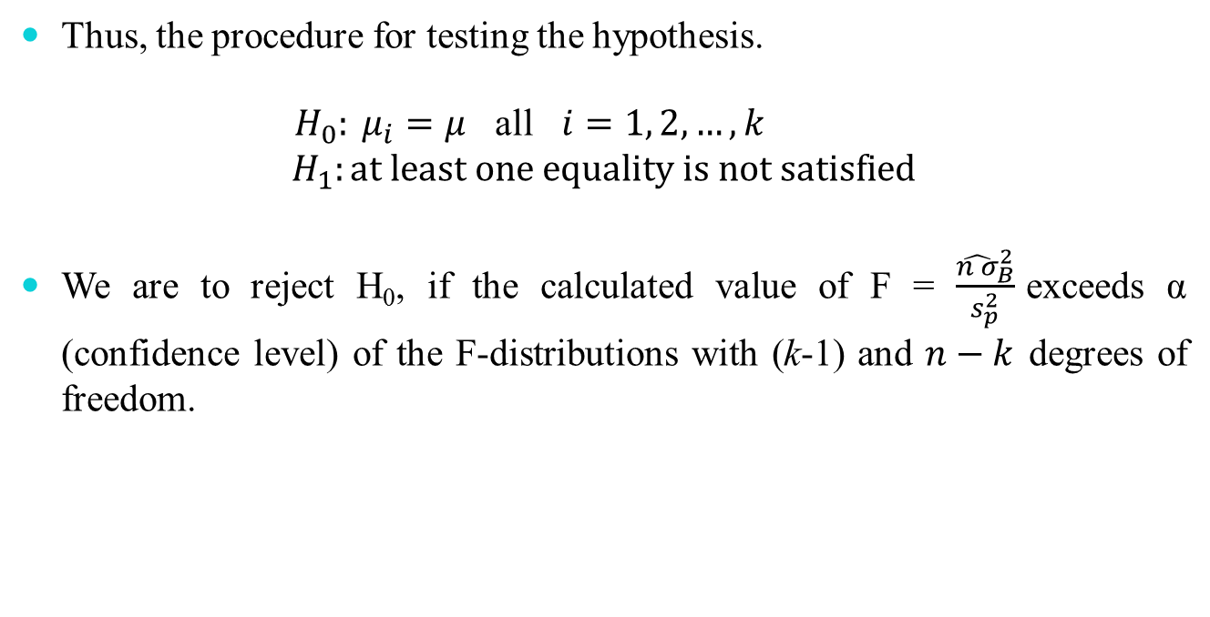
Heuristic Justification of ANOVA
Thus, the procedure for testing the hypothesis.
${ H}_{0}: μ_{i}=μ$ all $i=1, 2, …, k$
$$H_{1}:at least one equality is not satisfied$$
We are to reject H₀, if the calculated value of F = $\frac{{\hat{n σ}}_{B}^{2}}{s_{p}^{2}}$exceeds α (confidence level) of the F-distributions with (k-1) and $n−k$ degrees of freedom.

Slide 44
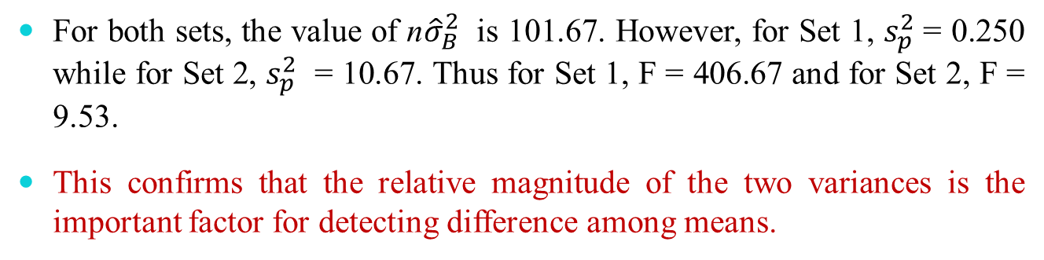
Example 6: F-Test
Set 1 |  |  | Set 2
Sample 1 | Sample 2 | Sample 3 | Sample 1 | Sample 2 | Sample 3
5.7 | 9.4 | 14.2 | 3.0 | 5.0 | 11.0
5.9 | 9.8 | 14.4 | 4.0 | 7.0 | 13.0
6.0 | 10.0 | 15.0 | 6.0 | 10.0 | 16.0
6.1 | 10.2 | 15.6 | 8.0 | 13.0 | 17.0
6.3 | 10.6 | 15.8 | 9.0 | 15.0 | 18.0
y¯ = 6.0 | y¯ = 10.0 | y¯ = 15.0 | y¯ = 6.0 | y¯ = 10.0 | y¯ = 15.0
For both sets, the value of n${\hat{σ}}_{B}^{2}$ is 101.67. However, for Set 1, $s_{p}^{2}$= 0.250 while for Set 2, $s_{p}^{2}$ = 10.67. Thus for Set 1, F = 406.67 and for Set 2, F = 9.53.
This confirms that the relative magnitude of the two variances is the important factor for detecting difference among means.

Slide 45

Example 7: Variance between Samples
The table below shows the lifetimes under controlled conditions, in hours in excess of 1000 hours, of samples of $60W$ electric light bulbs of three different brands.
Assuming all lifetimes to be normally distributed with common variance, test, at the $1\%$ significance level, the hypothesis that there is no difference between the three brands with respect to mean lifetime.
Brand
1 | 2 | 3
16 | 18 | 26
15 | 22 | 31
13 | 20 | 24
21 | 16 | 30
15 | 24 | 24

Slide 46
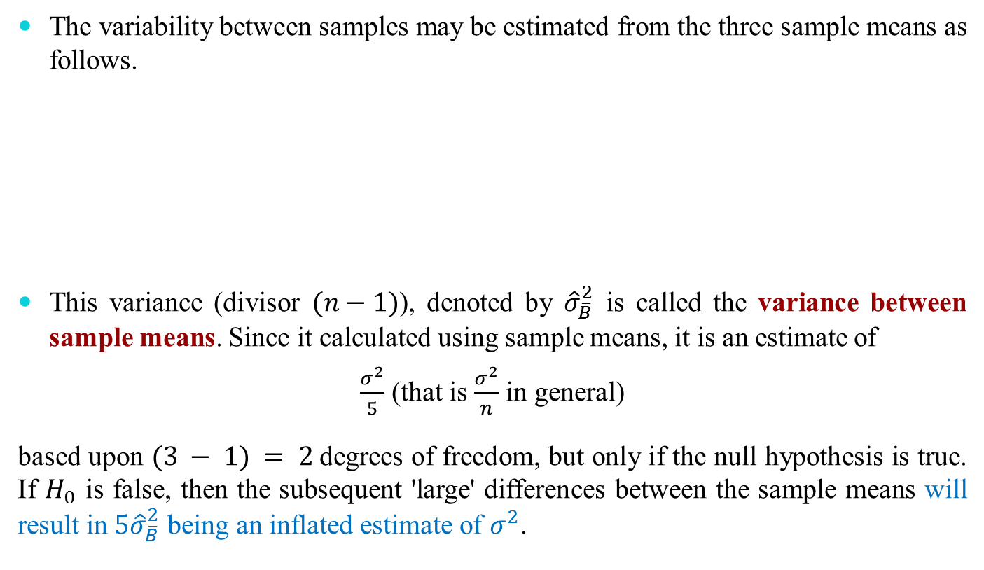
Solution : Variance between Samples
The variability between samples may be estimated from the three sample means as follows.
This variance (divisor $(n−1)$), denoted by ${\hat{σ}}_{\overline{B}}^{2}$ is called the variance between sample means. Since it calculated using sample means, it is an estimate of
$\frac{σ^{2}}{5}$ (that is $\frac{σ^{2}}{n}$ in general)
based upon $(3 − 1) = 2$degrees of freedom, but only if the null hypothesis is true. If $H_{0}$ is false, then the subsequent 'large' differences between the sample means will result in $5{\hat{σ}}_{\overline{B}}^{2}$ being an inflated estimate of $σ^{2}$.
 | Brand
 | 1 | 2 | 3
Sample Mean | 16 | 20 | 27
Sum |  | 63
Sum of squares |  | 1385
Mean |  | 21
Variance |  | 31

Slide 47
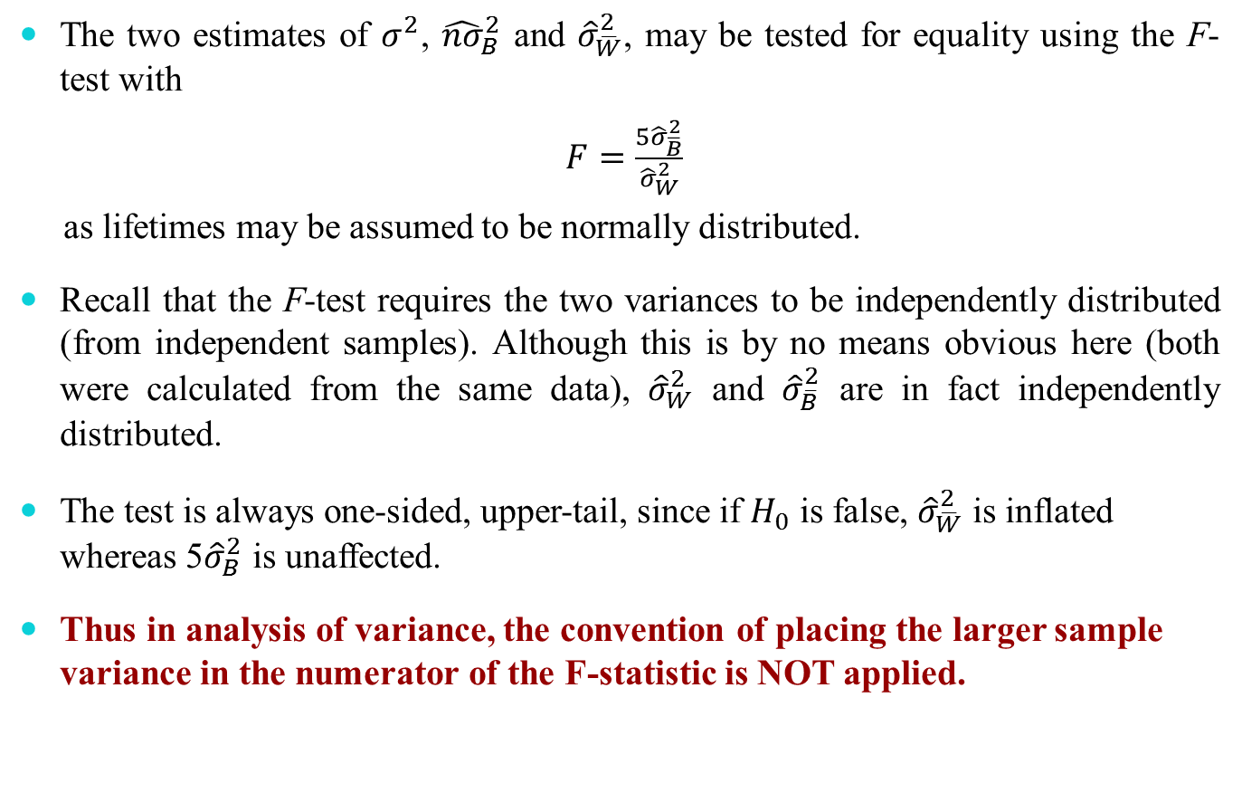
Solution : F-Test
The two estimates of $σ^{2}$, ${\hat{nσ}}_{B}^{2}$ and ${\hat{σ}}_{\overline{W}}^{2}$, may be tested for equality using the F-test with
$F=\frac{5{\hat{σ}}_{\overline{B}}^{2}}{{\hat{σ}}_{W}^{2}}$
as lifetimes may be assumed to be normally distributed.
Recall that the F-test requires the two variances to be independently distributed (from independent samples). Although this is by no means obvious here (both were calculated from the same data), ${\hat{σ}}_{W}^{2}$ and ${\hat{σ}}_{\overline{B}}^{2}$ are in fact independently distributed.
The test is always one-sided, upper-tail, since if $H_{0}$ is false, ${\hat{σ}}_{\overline{W}}^{2}$ is inflated whereas 5${\hat{σ}}_{B}^{2}$ is unaffected.
Thus in analysis of variance, the convention of placing the larger sample variance in the numerator of the F-statistic is NOT applied.

Slide 48
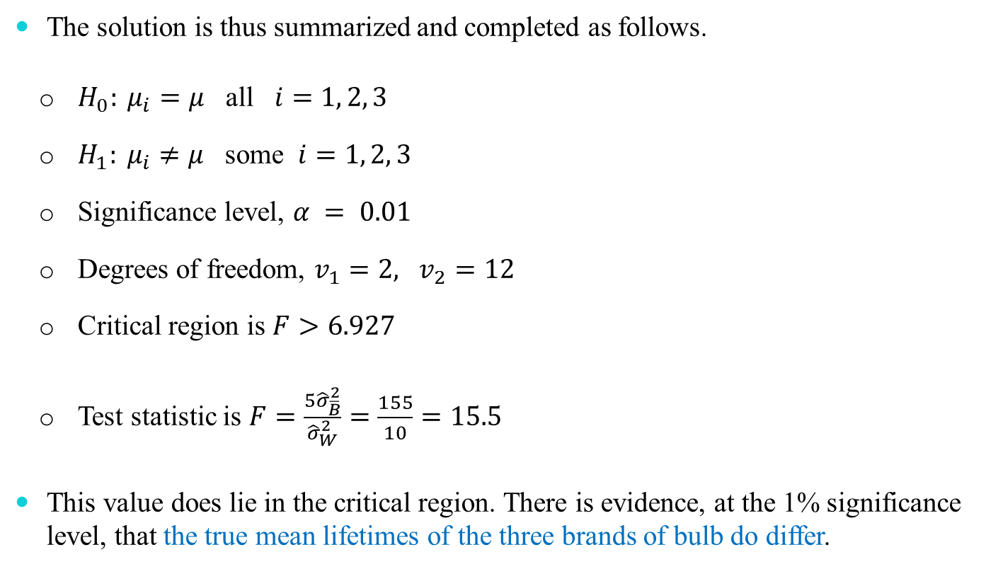
Solution
The solution is thus summarized and completed as follows.
$H_{0}: μ_{i}=μ$ all $i=1, 2, 3$
$H_{1}: μ_{i}≠μ$ some $i=1, 2, 3$
Significance level, $α = 0.01$
Degrees of freedom, $v_{1}=2, v_{2}=12$
Critical region is $F>6.927$
Test statistic is $F=\frac{5{\hat{σ}}_{\overline{B}}^{2}}{{\hat{σ}}_{W}^{2}}=\frac{155}{10}=15.5$
This value does lie in the critical region. There is evidence, at the 1% significance level, that the true mean lifetimes of the three brands of bulb do differ.

Slide 49
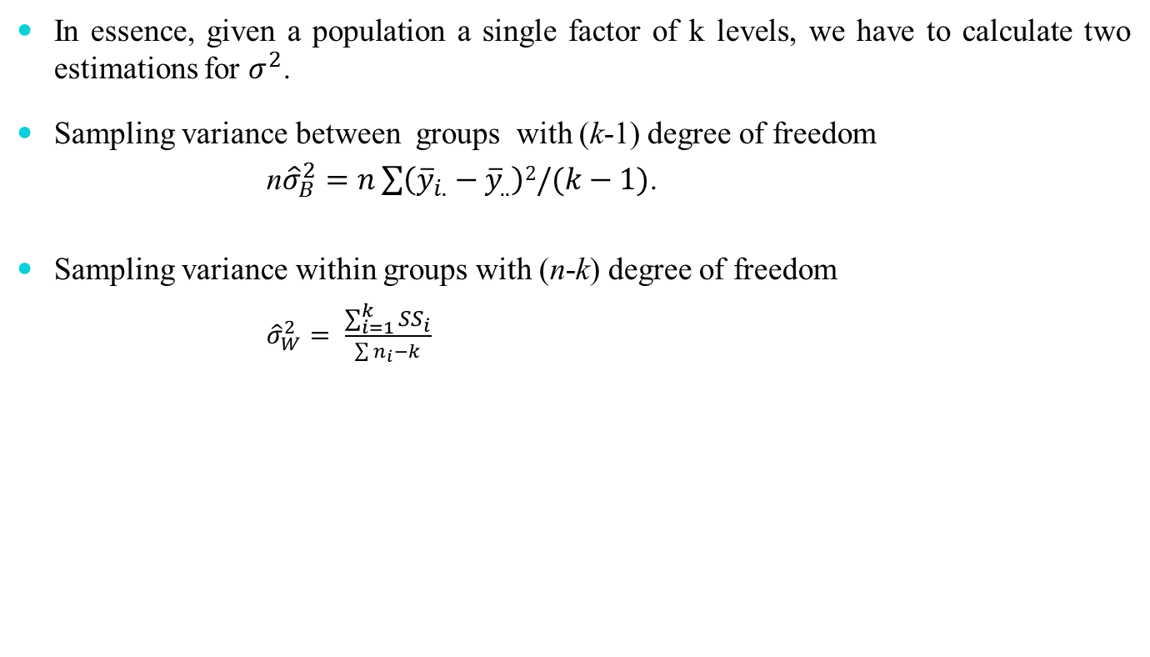
Notation and computational formulae
In essence, given a population a single factor of k levels, we have to calculate two estimations for $σ^{2}$.
Sampling variance between groups with (k-1) degree of freedom
n${\hat{σ}}_{B}^{2}=n\sum{\left({\overline{y}}_{i.}−{\overline{y}}_{..}\right)2/(k−1)}$.
Sampling variance within groups with (n-k) degree of freedom
${\hat{σ}}_{W}^{2}= \frac{\sum_{i=1}^{k}{{SS}_{i}}}{\sum{n_{i}−k}}$

Slide 50
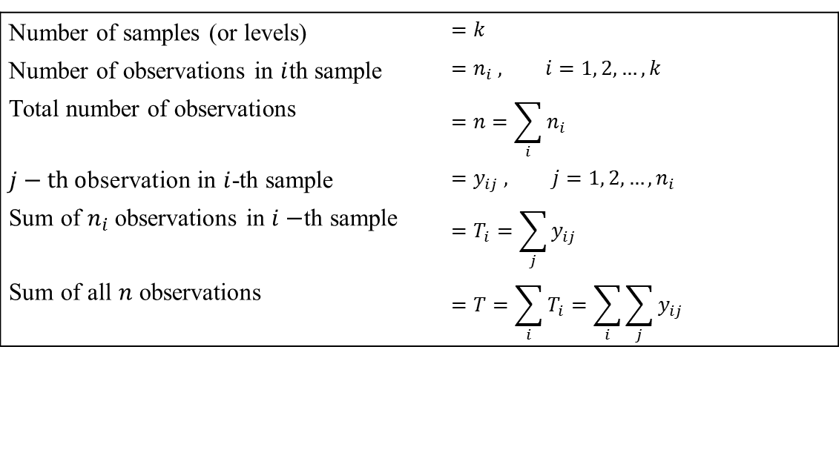
Notation and computational formulae
The calculations undertaken in the previous example are somewhat cumbersome, and are prone to inaccuracy with non-integer sample means. They also require considerable changes when the sample sizes are unequal. Equivalent computational formulae are available which cater for both equal and unequal sample sizes.
First, some notation.
Number of samples (or levels) | $$=k$$
Number of observations in $i$th sample | $$=n_{i} , i=1, 2, …, k$$
Total number of observations | $$=n=\sum_{i}{n_{i}}$$
$j−th \text{o}\text{bservation}$ in $i$-th sample | $$=y_{ij} , j=1, 2, …,n_{i}$$
Sum of $n_{i}$observations in $i−$th sample | $$=T_{i}=\sum_{j}{y_{ij}}$$
Sum of all $n$ observations | $$=T=\sum_{i}{T_{i}}=\sum_{i}{\sum_{j}{y_{ij}}}$$

Slide 51
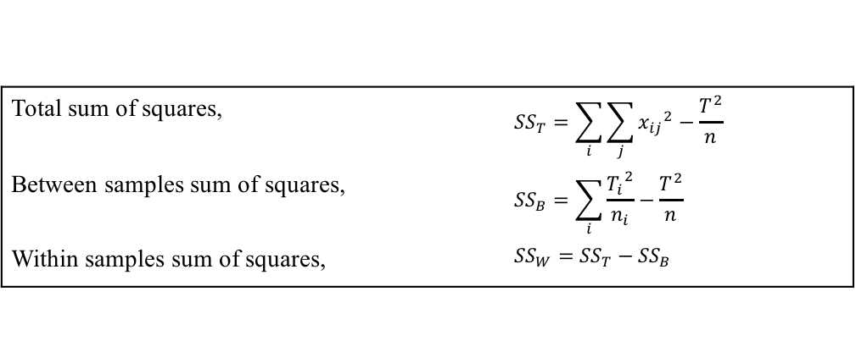

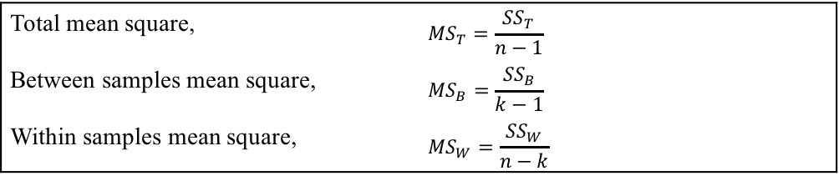
Notation and computational formulae
The computational formulae now follow.
A mean square (or unbiased variance estimate) is given by
(sum of squares) ÷ (degrees of freedom)
e.g. ${\hat{σ}}^{2}=\frac{{\left(x−\overline{x}\right)}^{2}}{n−1}$
Hence
Note that for the degrees of freedom: (𝑘 − 1) + (𝑛 − 𝑘 ) = (𝑛 − 1)
Total sum of squares, | $${SS}_{T}=\sum_{i}{\sum_{j}{{x_{ij}}^{2}}}−\frac{T^{2}}{n}$$
Between samples sum of squares, | $${SS}_{B}=\sum_{i}{\frac{{T_{i}}^{2}}{n_{i}}}−\frac{T^{2}}{n}$$
Within samples sum of squares, | $${SS}_{W}={SS}_{T}−{SS}_{B}$$
Total mean square, | $${MS}_{T}=\frac{{SS}_{T}}{n−1}$$
Between samples mean square, | $${MS}_{B}=\frac{{SS}_{B}}{k−1}$$
Within samples mean square, | $${MS}_{W}=\frac{{SS}_{W}}{n−k}$$

Slide 52
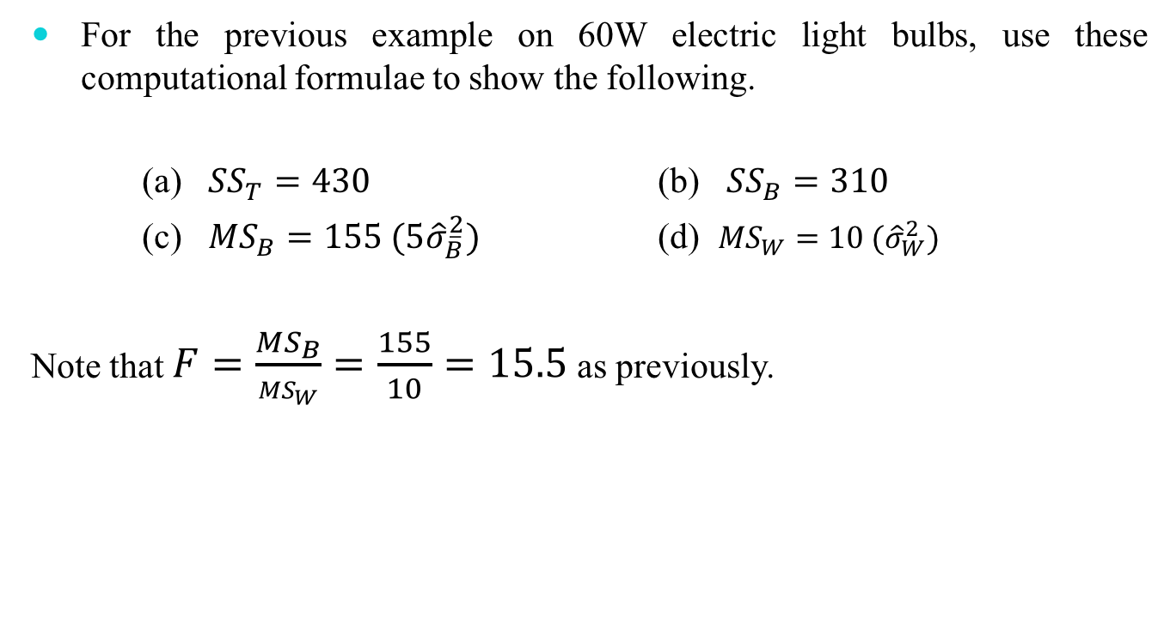
Example 8: F-Test using Formula
For the previous example on 60W electric light bulbs, use these computational formulae to show the following.
(a) ${SS}_{T}=430$ (b) ${SS}_{B}=310$
(c) ${MS}_{B}=155 (5{\hat{σ}}_{\overline{B}}^{2})$ (d) ${MS}_{W}=10 ({\hat{σ}}_{W}^{2})$
Note that $F=\frac{{MS}_{B}}{{MS}_{W}}=\frac{155}{10}=15.5$as previously.

Slide 53
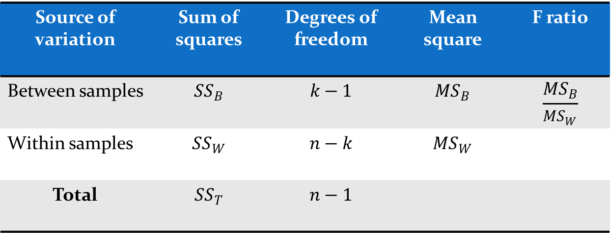
ANOVA Table
It is convenient to summarize the results of an analysis of variance in a table. For a one factor analysis this takes the following form.
Source of variation | Sum of squares | Degrees of freedom | Mean square | F ratio
Between samples | $${SS}_{B}$$ | $$k−1$$ | $${MS}_{B}$$ | $$\frac{{MS}_{B}}{{MS}_{W}}$$
Within samples | $${SS}_{W}$$ | $$n−k$$ | $${MS}_{W}$$
Total | $${SS}_{T}$$ | $$n−1$$

Slide 54
Example 9: F-Test for unbalanced
In a comparison of the cleaning action of four detergents, 20 pieces of white cloth were first soiled with India ink. The cloths were then washed under controlled conditions with 5 pieces washed by each of the detergents. Unfortunately three pieces of cloth were 'lost' in the course of the experiment. Whiteness readings, made on the 17 remaining pieces of cloth, are shown below.
Assuming all whiteness readings to be normally distributed with common variance, test the hypothesis of no difference between the four brands as regards mean whiteness readings after washing.
Detergent
A | B | C | D
77 | 74 | 73 | 76
81 | 66 | 78 | 85
61 | 58 | 57 | 77
76 |  | 69 | 64
69 |  | 63

Slide 55

Solution
$H_{0}: μ_{i}=μ$ all $i=1, 2, 3$
$H_{1}: μ_{i}≠μ$ some $i=1, 2, 3$
Significance level, $α = 0.05$(say)
Degrees of freedom, $v_{1}=k−1=3,$
and$v_{2}=n−k=17−4=13$
Critical region is $F>3.411$

Slide 56
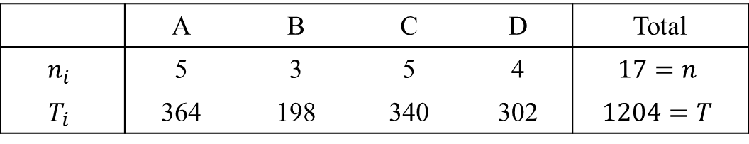

Solution
$$\sum_{i}{\sum_{j}{{y_{ij}}^{2}}=86362}$$
$${SS}_{T}=86362−\frac{{1204}^{2}}{17}=1090.47$$
$${SS}_{B}=\left(\frac{{364}^{2}}{5}+\frac{{198}^{2}}{3}+\frac{{340}^{2}}{5}+\frac{{302}^{2}}{4}\right)−\frac{{1204}^{2}}{17}=216.67$$
$${SS}_{W}=1090.47−216.67=873.80$$
 | A | B | C | D | Total
$$n_{i}$$ | 5 | 3 | 5 | 4 | $$17=n$$
$$T_{i}$$ | 364 | 198 | 340 | 302 | $$1204=T$$

Slide 57
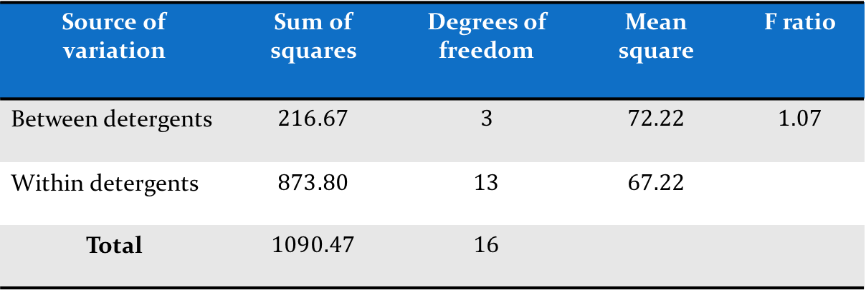
Solution
The ANOVA table is now as follows.
The F ratio of 1.07 does not lie in the critical region.
Thus there is no evidence, at the 5% significance level, to suggest a difference between the four brands as regards mean whiteness after washing.
Source of variation | Sum of squares | Degrees of freedom | Mean square | F ratio
Between detergents | $$216.67$$ | $$3$$ | $$72.22$$ | $$1.07$$
Within detergents | $$873.80$$ | $$13$$ | $$67.22$$
Total | $$1090.47$$ | $$16$$

Slide 58
Two-way ANOVA

Slide 59
Two way (factor) anova
This is an extension of the one factor situation to take account of a second factor.
The levels of this second factor are often determined by groupings of subjects or units used in the investigation. As such it is often called a blocking factor because it places subjects or units into homogeneous groups called blocks. The design itself is then called a randomised block design.

Slide 60
Example 10: Two-factor Analysis
A computer manufacturer wishes to compare the speed of four of the firm's compilers. The manufacturer can use one of two experimental designs.
Use 20 similar programs, randomly allocating 5 programs to each compiler.
Use 4 copies of any 5 programs, allocating 1 copy of each program to each compiler.
Which of (a) and (b) would you recommend, and why?

Slide 61
Solution
In (a), although the 20 programs are similar, any differences between them may affect the compilation times and hence perhaps any conclusions. Thus in the 'worst scenario', the 5 programs allocated to what is really the fastest compiler could be the 5 requiring the longest compilation times, resulting in the compiler appearing to be the slowest! If used, the results would require a one factor analysis of variance; the factor being compiler at 4 levels.
In (b), since all 5 programs are run on each compiler, differences between programs should not affect the results. Indeed it may be advantageous to use 5 programs that differ markedly so that comparisons of compilation times are more general. For this design, there are two factors; compiler (4 levels) and program (5 levels). The factor of principal interest is compiler whereas the other factor, program, may be considered as a blocking factor as it creates 5 blocks each containing 4 copies of the same program.
Thus (b) is the better designed investigation.

Slide 62
Solution
The actual compilation times, in milliseconds, for this two factor (randomised block) design are shown in the following table.
 | Compiler
 | 1 | 2 | 3 | 4
Program A | 29.21 | 28.25 | 28.20 | 28.62
Program B | 26.18 | 26.02 | 26.22 | 25.56
Program C | 30.91 | 30.18 | 30.52 | 30.09
Program D | 25.14 | 25.26 | 25.20 | 25.02
Program E | 26.16 | 25.16 | 25.26 | 25.46

Slide 63
Assumptions and Interaction
The three assumptions for a two factor analysis of variance when there is only one observed measurement at each combination of levels of the two factors are as follows.
The population at each factor level combination is (approximately) normally distributed.
These normal populations have a common variance, σ 2 .
The effect of one factor is the same at all levels of the other factor.
Hence from assumptions 1 and 2, when one factor is at level i and the other at level j, the population has a distribution which is N(μij, σ²)
Assumption 3 is equivalent to stating that there is no interaction between the two factors.

Slide 64
Assumptions and Interaction
Now interaction exists when the effect of one factor depends upon the level of the other factor. For example consider the effects of the two factors: sugar (levels none and 2 teaspoons), and stirring (levels none and 1 minute), on the sweetness of a cup of tea.
Stirring has no effect on sweetness if sugar is not added but certainly does have an effect if sugar is added. Similarly, adding sugar has little effect on sweetness unless the tea is stirred.
Hence factors sugar and stirring are said to interact.
Interaction can only be assessed if more than one measurement is taken at each combination of the factor levels. Since such situations are beyond the scope of this text, it will always be assumed that interaction between the two factors does not exist.

Slide 65
Assumptions and Interaction
Thus, for example, since it would be most unusual to find one compiler particularly suited to one program, the assumption of no interaction between compilers and programs appears reasonable.

Slide 66
Notation and Computational Formulae
As illustrated earlier, the data for a two-way ANOVA can be displayed in a two-way table. It is thus convenient, in general, to label the factors as
a row factor and a column factor.
Notation, similar to that for the one factor case, is then as follows.
Number of levels of row factor | = 𝑟
Number of levels of column factor | = 𝑐
Total number of observations | = 𝑟𝑐
Observation in (i j-th cell of table | = 𝑥_{𝑖𝑗}
(ith level of row factor and jth level of column factor) | 𝑖=1,2,…,r 𝑗=1,2,…,c

Slide 67
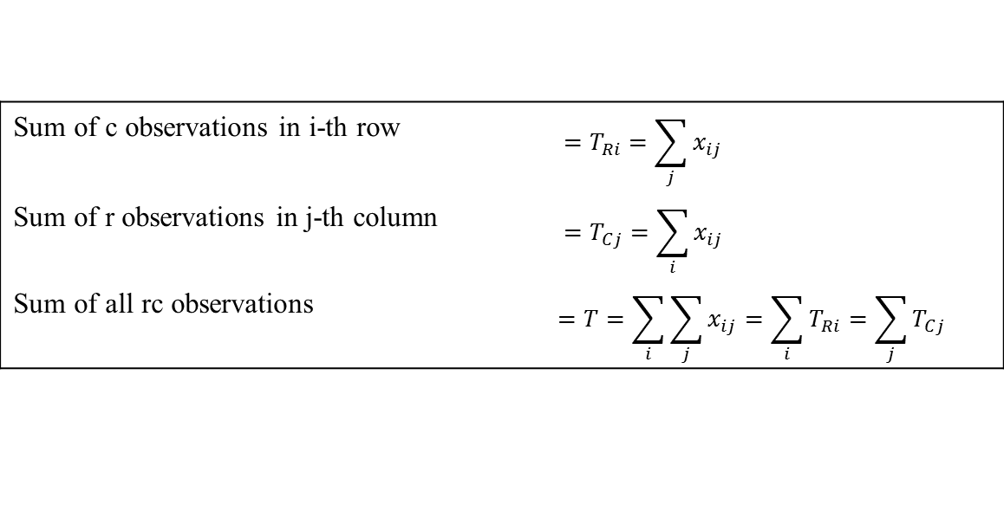
Notation and computational formulae
These lead to the following computational formulae which again are similar to those for one-way ANOVA except that there is an additional sum of squares, etc. for the second factor.
Sum of c observations in i-th row | $$=T_{Ri}=\sum_{j}{x_{ij}}$$
Sum of r observations in j-th column | $$=T_{Cj}=\sum_{i}{x_{ij}}$$
Sum of all rc observations | $$=T=\sum_{i}{\sum_{j}{x_{ij}}}=\sum_{i}{T_{Ri}}=\sum_{j}{T_{Cj}}$$

Slide 68
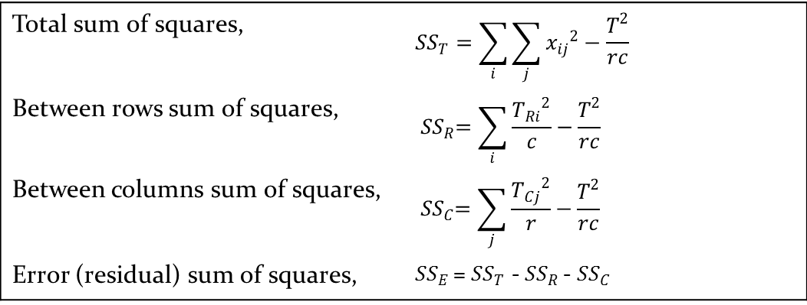
Notation and computational formulae
Total sum of squares, | $${SS}_{T}=\sum_{i}{\sum_{j}{{x_{ij}}^{2}}}−\frac{T^{2}}{rc}$$
Between rows sum of squares, | $${ SS}_{R}=\sum_{i}{\frac{{T_{Ri}}^{2}}{c}}−\frac{T^{2}}{rc}$$
Between columns sum of squares, | $${ SS}_{C}=\sum_{j}{\frac{{T_{Cj}}^{2}}{r}}−\frac{T^{2}}{rc}$$
Error (residual) sum of squares, | ${SS}_{E }$= ${SS}_{T}$ - ${SS}_{R }$- ${SS}_{C}$
What are the degrees of freedom for SST , SSR and SSC when
there are 20 observations in a table of 5 rows and 4 columns?
What is the degrees of freedom of SSE ?

Slide 69
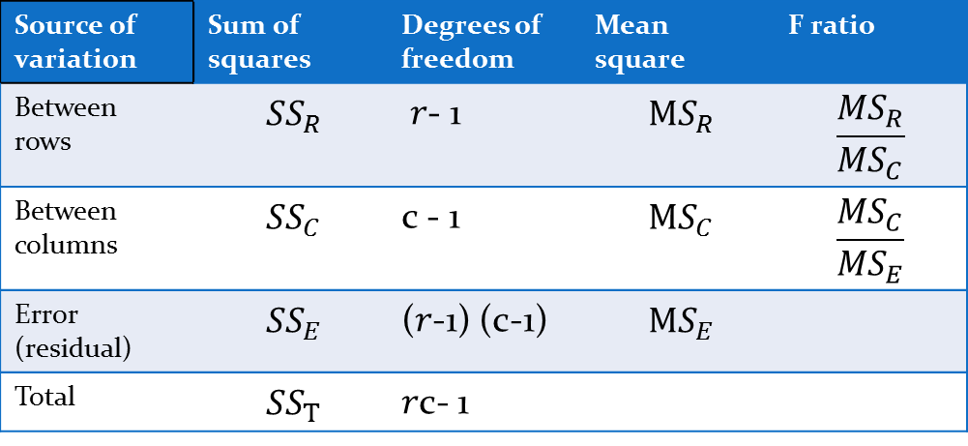

ANOVA Table and Hypothesis Test
For a two factor analysis of variance this takes the following form.
Notes :
The three sums of squares, ${ SS}_{R}$ , ${ SS}_{C}$ and ${ SS}_{E}$ are independently distributed.
For the degrees of freedom: (𝑟-1)+ (c-1) +(𝑟-1)+ (c-1) = 𝑟c- 1
Source of variation | Sum of squares | Degrees of freedom | Mean square | F ratio
Between rows | $${ SS}_{R}$$ | 𝑟- 1 | $${ MS}_{R}$$ | $$\frac{{MS}_{R}}{{MS}_{C}}$$
Between columns | $${ SS}_{C}$$ | c - 1 | $${ MS}_{C}$$ | $$\frac{{MS}_{C}}{{MS}_{E}}$$
Error (residual) | $${ SS}_{E}$$ | (𝑟-1) (c-1) | $${ MS}_{E}$$
Total | $${ SS}_{T}$$ | 𝑟c- 1

Slide 70
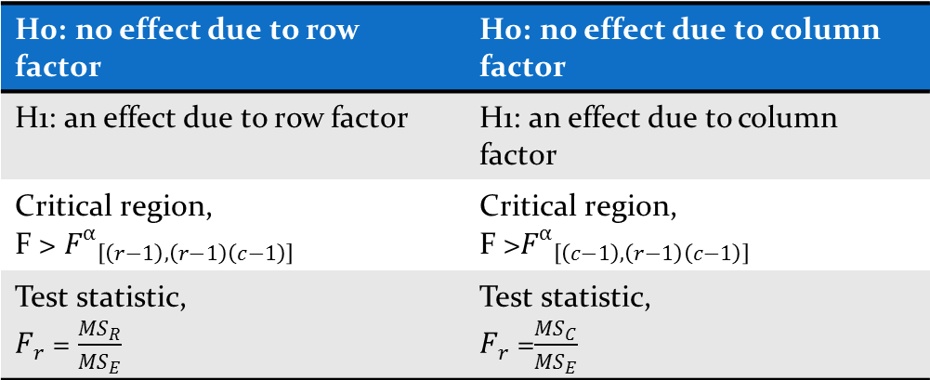
ANOVA Table and Hypothesis Test
Using the F ratios, tests for significant row effects and for significant column effects can be undertaken.
H0: no effect due to row factor | H0: no effect due to column factor
H1: an effect due to row factor | H1: an effect due to column factor
Critical region, F > ${F^{α}}_{\left[\left(r−1\right),\left(r−1\right)\left(c−1\right)\right]}$ | Critical region, F >${F^{α}}_{\left[\left(c−1\right),\left(r−1\right)\left(c−1\right)\right]}$
Test statistic, $F_{r}$ = $\frac{{MS}_{R}}{{MS}_{E}}$ | Test statistic, $F_{r}$ =$\frac{{MS}_{C}}{{MS}_{E}}$

Slide 71
Example 11: Two-way ANOVA
Returning to the compilation times, in milliseconds, for each of five programs, run on four compilers.
Test, at the 1% significance level, the hypothesis that there is no difference between the performance of the four compilers.
Has the use of programs as a blocking factor proved worthwhile? Explain.
The data, given earlier, are reproduced below.
 | Compiler
 | 1 | 2 | 3 | 4
Program A | 29.21 | 28.25 | 28.20 | 28.62
Program B | 26.18 | 26.02 | 26.22 | 25.56
Program C | 30.91 | 30.18 | 30.52 | 30.09
Program D | 25.14 | 25.26 | 25.20 | 25.02
Program E | 26.16 | 25.16 | 25.26 | 25.46

Slide 72
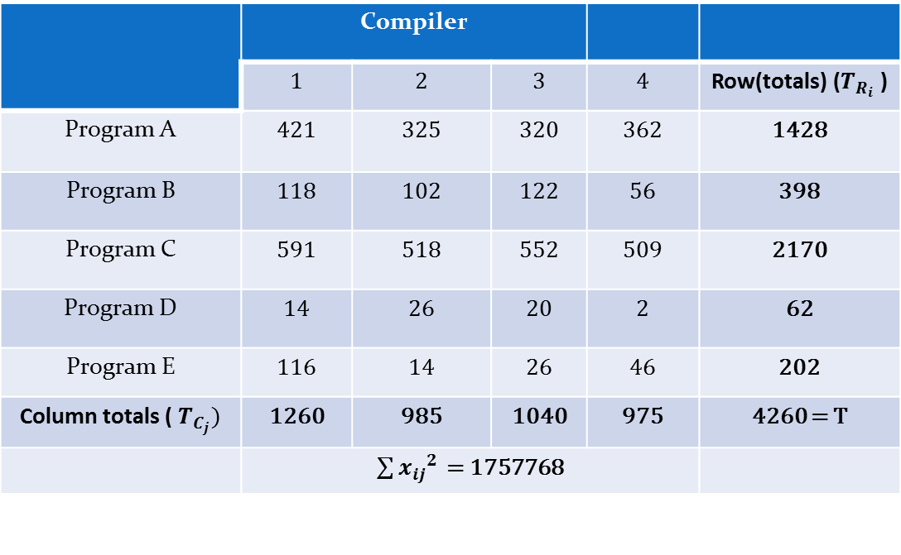
Solution : Dataset
To ease computations, these data have been transformed (coded) by x = 100 × (time -25)
to give the following table of values and totals.
 | Compiler
 | 1 | 2 | 3 | 4 | Row(totals) ($T_{R_{i}}$ )
Program A | 421 | 325 | 320 | 362 | 1428
Program B | 118 | 102 | 122 | 56 | 398
Program C | 591 | 518 | 552 | 509 | 2170
Program D | 14 | 26 | 20 | 2 | 62
Program E | 116 | 14 | 26 | 46 | 202
Column totals (${ T}_{C_{j}})$ | 1260 | 985 | 1040 | 975 | 4260 = T
 | $\sum{{x_{ij}}^{2 }}$ = 1757768

Slide 73
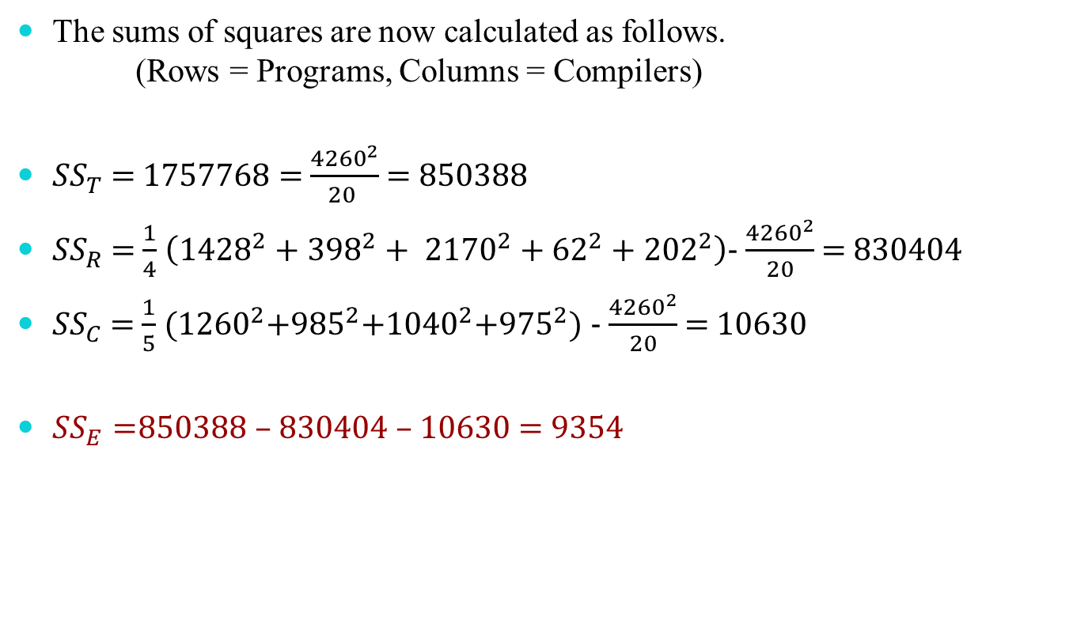
Solution : Parameters
The sums of squares are now calculated as follows. (Rows = Programs, Columns = Compilers)
${SS}_{T}$ = 1757768 = $\frac{{4260}^{2}}{20 }$ = 850388
${SS}_{R}$ = $\frac{1}{4}$ $\left({1428}^{2}+{398}^{2}+ {2170}^{2}+{62}^{2}+{202}^{2}\right)$- $\frac{{4260}^{2}}{20}$ = 830404
${SS}_{C}$ = $\frac{1}{5}$ (${1260}^{2}$+${985}^{2}$+${1040}^{2}$+${975}^{2}$) - $\frac{{4260}^{2}}{20}$ = 10630
${SS}_{E}=$850388 – 830404 – 10630 = 9354

Slide 74
Solution: ANOVA Table
Source of variation | Sum of squares | Degrees of freedom | Mean square | F ratio
Between programs | 830404 | 4 | 207601.0 | 266.33
Between compilers | 10630 | 3 | 3543.3 | 4.55
Error (residual) | 9354 | 12 | 779.5
Total | 850388 | 19

Slide 75
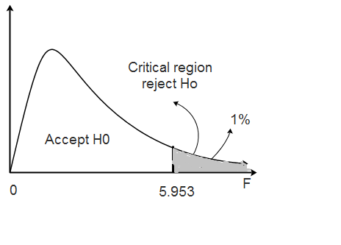
Solution : Hypothesis Test
H0: no effect on compilation times due to compilers
H1: an effect on compilation times due to compilers
Significance level, α = 0.001
Degrees of freedom, v1 = c − 1 = 3
and v2 = ( r − 1)( c − 1) = 4 × 3 = 12
Critical region is F > 5.953
Test statistic FC = 4.55
This value does not lie in the critical region. Thus there is no evidence, at the 1% significance level, to suggest a difference in compilation times between the four compilers.

Slide 76
Reference
The detail material related to this lecture can be found in
Design and Analysis of Experiments (8th Edition), Douglas C. Montgomery, John Wiley & Sons, 2013.

